Slide 1
Density Functional Theory, Dispersion
Instructor: Prof. Tzuhsiung (Nick) Yang
Email: tyang@mx.nthu.edu.tw
Time: M5/6
Room: NTHU Library Comp Lab II
Notes:
Rafael Gomez

Slide 2
Suggested reading
Chapter 8 in Cramer, C. J. Essentials of Computational Chemistry: Theories and Models; John Wiley & Sons, 2013.
Cohen, A. J.; Mori-Sánchez, P.; Yang, W. Challenges for Density Functional Theory. Chem. Rev. 2012, 112 (1), 289–320.
Mardirossian, N.; Head-Gordon, M. Thirty Years of Density Functional Theory in Computational Chemistry: An Overview and Extensive Assessment of 200 Density Functionals. Molecular Physics 2017, 115 (19), 2315–2372.

Slide 3
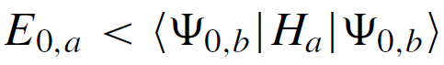
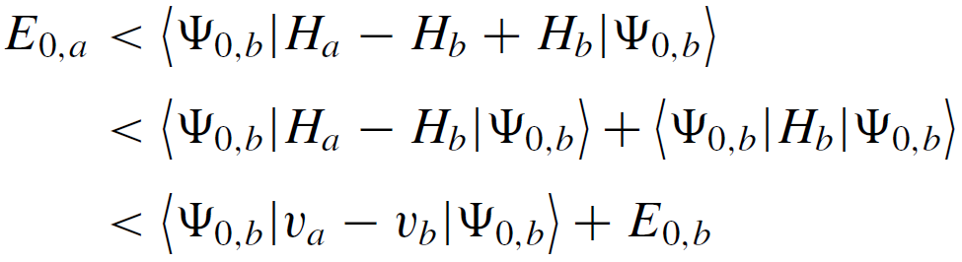
The Hohenberg-Kohn Existence Theorem
To prove that the ground-state density defines the operator that described the external potential experienced by the electrons, Hohenberg and Kohn proceeded via reductio ad absurdum (歸謬法):
The expectation value of the Hamiltonian a over the wave function b much be higher than the ground state energy of a
Add and substrate the Hamiltonian b

Slide 4
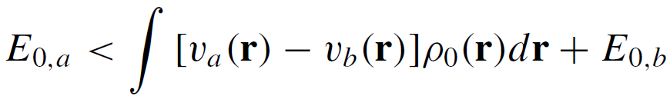
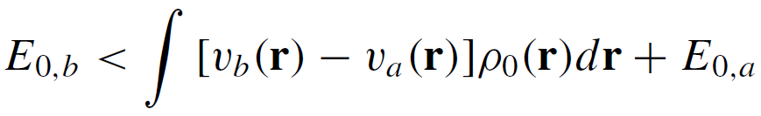
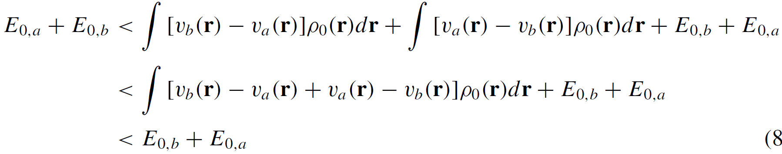
The Hohenberg-Kohn Existence Theorem
Since the potentials v are one-electron operators
Since a and b are dummy variables
Add these two equations together
which is impossible.

Slide 5
The Hohenberg-Kohn Variational Theorem
The HK existence theorem proves that the non-degenerate ground-state density must determine the external potential, and thus the Hamiltonian, and thus the wave function. However, it does not tell us how to predict the density.
Since density determines H and Ψ, we can keep varying the density and its associated H and Ψ until the energy converges by the variational principle.
But this is no difference from the HF theory…

Slide 6
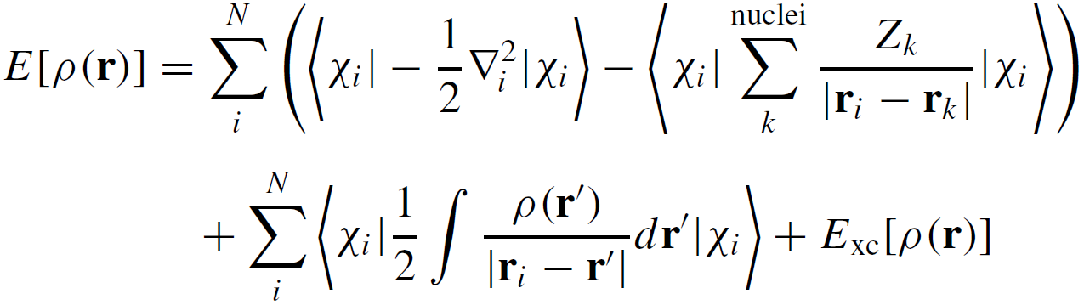
Kohn-Sham SCF methodology
Let’s assume a fictitious system of non-interacting electrons that have the same ground-state density as the real system in which electrons do interact.
We can write the energy functional of this density as
In the form of orbital expression
in which is a Slater determinant and E_{xc}[ρ(r)] is the exchange-correlation energy, which is responsible to get ΔT[ρ(r)] + ΔV_{ee}[ρ(r)] correct.

Slide 7
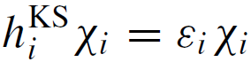
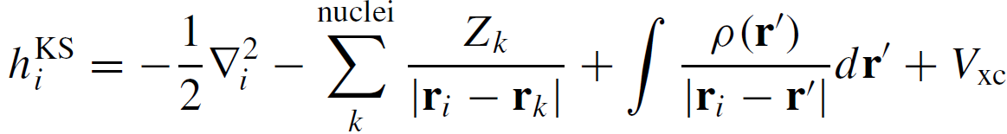
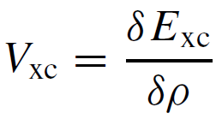
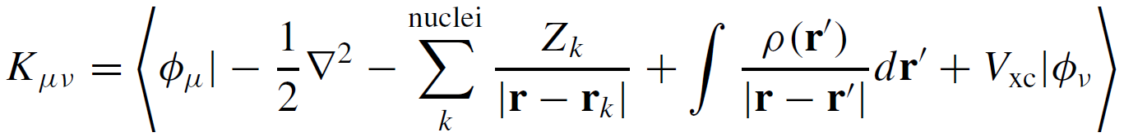
Kohn-Sham SCF methodology
In the form of operator equation
is called functional derivative
We can obtain the orbitals from linear combination of atomic orbitals

Slide 8
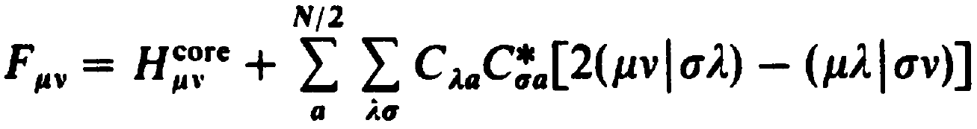

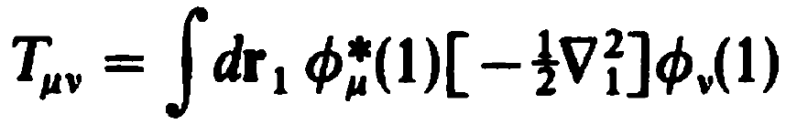
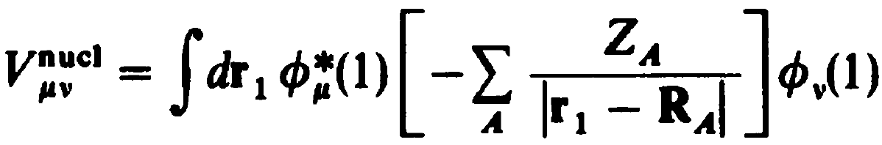
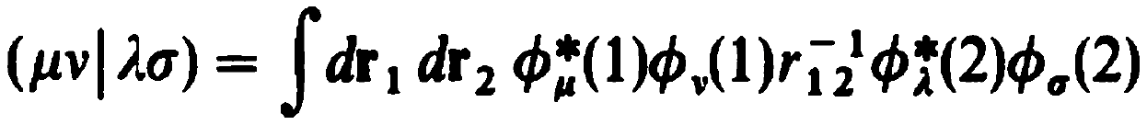
Kohn-Sham SCF methodology
And we have seen a similar equation, which is just the HF equation in Roothaan’s form

Slide 9
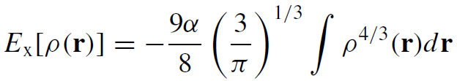
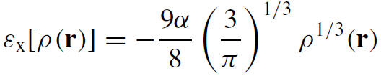
Functional form
Now, we just need a good expression for V_{xc}
For a uniform electron gas (UEG), such as in the fictitious substance “jellium” in which an infinite number of electrons in an infinite volume of space with a uniformly distributed positive charge, Ex was separately derived by Slater (α = 1), Bloch and Dirac (α = 2/3)
The corresponding functional derivative, of ‘energy density’
This functional derivative cancels out self-interaction error in a UEG

Slide 10
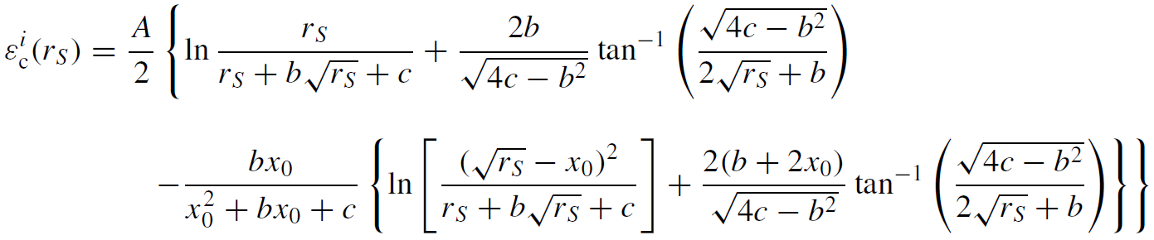
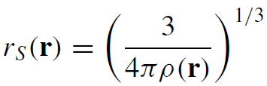
Functional form
Unfortunately, no analytical derivation has been found for the correlation energy density even for UEG. Hence, instead, Vosko, Wilk, and Nusair (VWN) proposed a local functionals that fit numerical results of simulations of correlations energies from quantum Monte Carlo techniques.
The constants A, x0, b, and c were fitted.

Slide 11
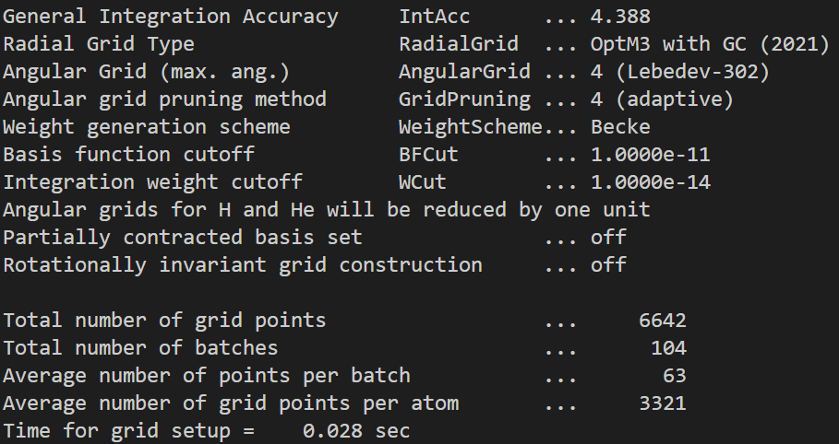
Evaluation of the energy
The complex form of the correlation function renders analytical integration of the KS equation impossible. Therefore, the evaluation of KS equation is almost always performed on a numerical grid

Slide 12
Functional form
Combining the ε_{X} and ε_{C} gives us an exchange-correlation functional under the Local (Spin) Density Approximation (LSDA) called SVWN (Slater exchange + Vosko, Wilk, and Nusair correlation functionals). This is the LSDA used in B3LYP.
It is not too hard to see that this is functional is going to fail catastrophically for electron distributions that deviate from UEG, which is nearly all the cases in real life.
How do we go about improving the functional derivatives?

Slide 13
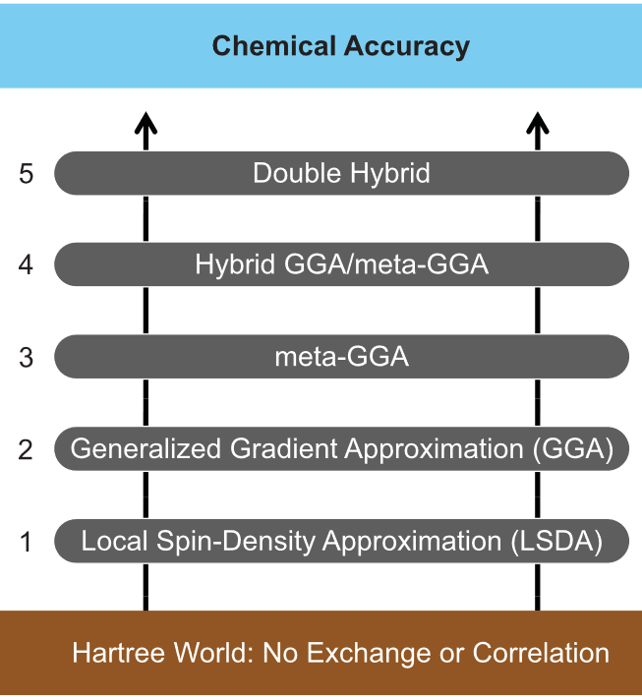
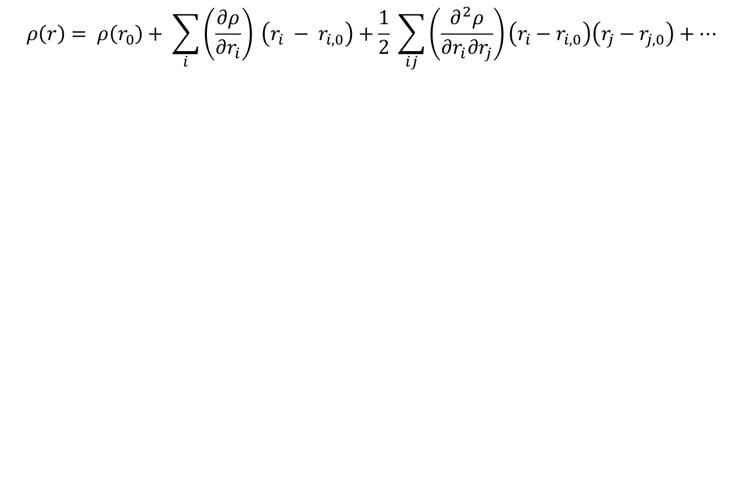
Jacob’s ladder
$$ρ\left(r\right)= ρ\left(r_{0}\right)+ \sum_{i}{\left(\frac{∂ρ}{∂r_{i}}\right)} \left(r_{i} − r_{i,0}\right)+\frac{1}{2} \sum_{ij}{\left(\frac{∂^{2}ρ}{∂r_{i}∂r_{j}}\right)}\left(r_{i}−r_{i,0}\right)\left(r_{j}−r_{j,0}\right)+…$$

Slide 14
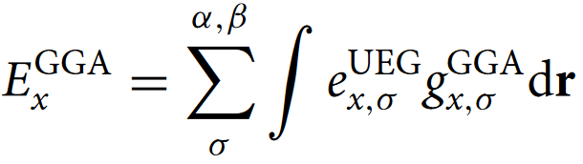
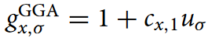
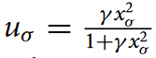
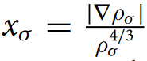
Generalized gradient approximation (GGA)
The correction to the UEG is the inclusion of an inhomogeneity correction factor (ICF). One of these corrections is functions that depend on the gradient of electron density ( ).
Becke in 1988 and Perdew, Burke, Ernzerhof in 1996 proposed a simple ICF with dimensionless gradient x_{σ}
,
and
with different non-linear parameters γ
Some common GGA exchange functionals: B88 (Becke), PW91, PBE, revPBE, RPBE (Perdew and Burke)
Some common GGA correlation functionals: P86 (Perdew), LYP (Parr), PW91 (Perdew)0, PBE (Perdew and Burke)

Slide 15
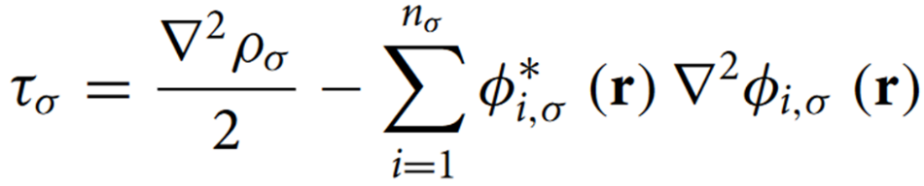
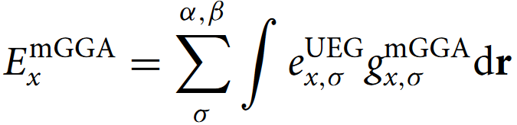
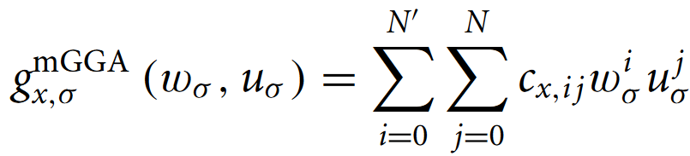
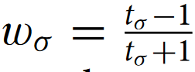
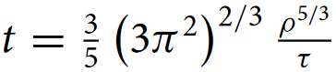
Meta-GGA
Naturally, the next level improvement comes from the Laplacian of the density and the kinetic energy density. These two quantities are related:
The corresponding exchange energy is
,
With the kinetic energy density ICF function being
,
Some common GGA exchange-correlation functionals: TPSS (Perdew), SCAN (Perdew), M06L (Truhlar), B97 (Becke), mBEEF (Bligaard)

Slide 16
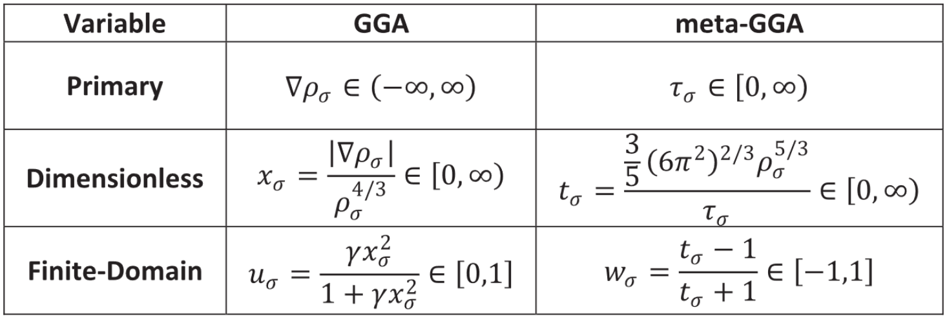
Summary of pure DFT

Slide 17
Interactive
Navigate to CompChem/Practice/Week4/Exercise2
qsub xc_r.sub
watch -n 10 qstat -u ${USER}
After the submitted job disappears from qstat, open pure_functional_properties.ipynb and run it
open pure_functional_sie_plot.ipynb and run it

Slide 18
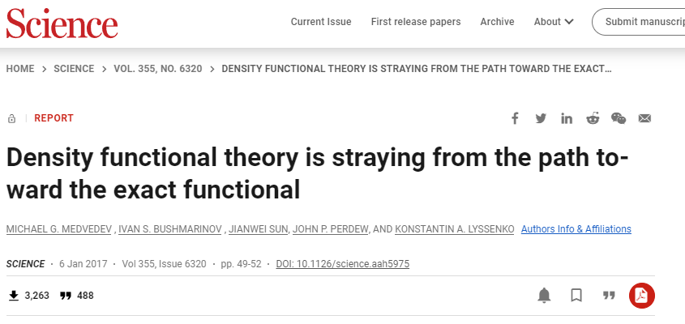
Is DFT non-empirical?
Medvedev, M. G.; Bushmarinov, I. S.; Sun, J.; Perdew, J. P.; Lyssenko, K. A. Density Functional Theory Is Straying from the Path toward the Exact Functional. Science 2017, 355 (6320), 49–52.

Slide 19
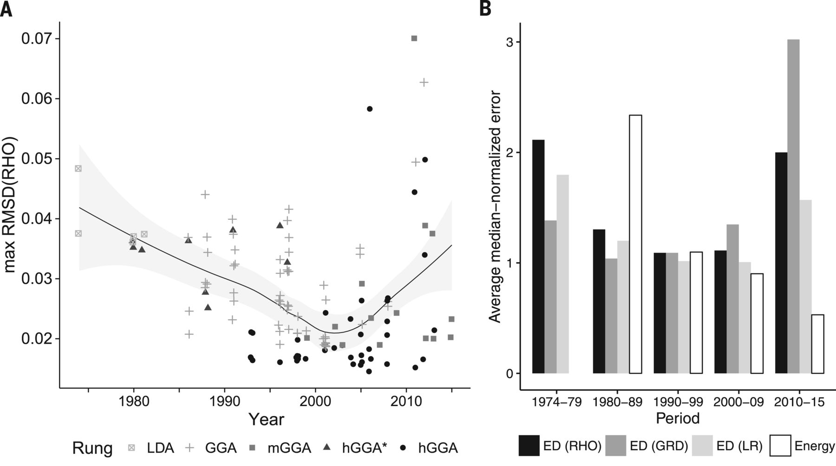
Is DFT non-empirical?

Slide 20
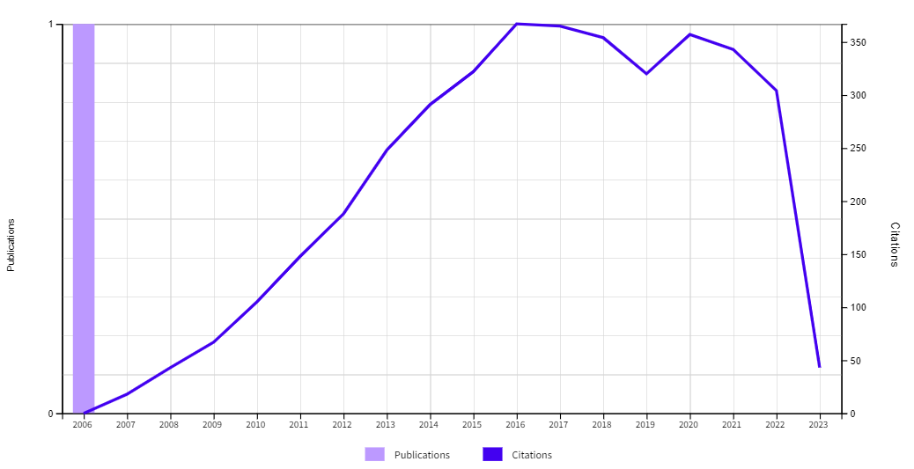
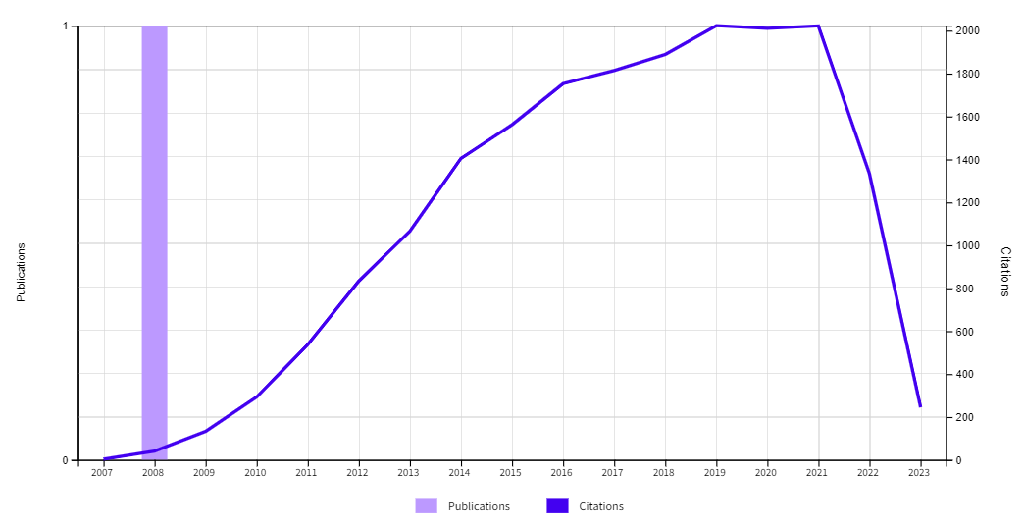
Is DFT non-empirical?
M06L
M06

Slide 21
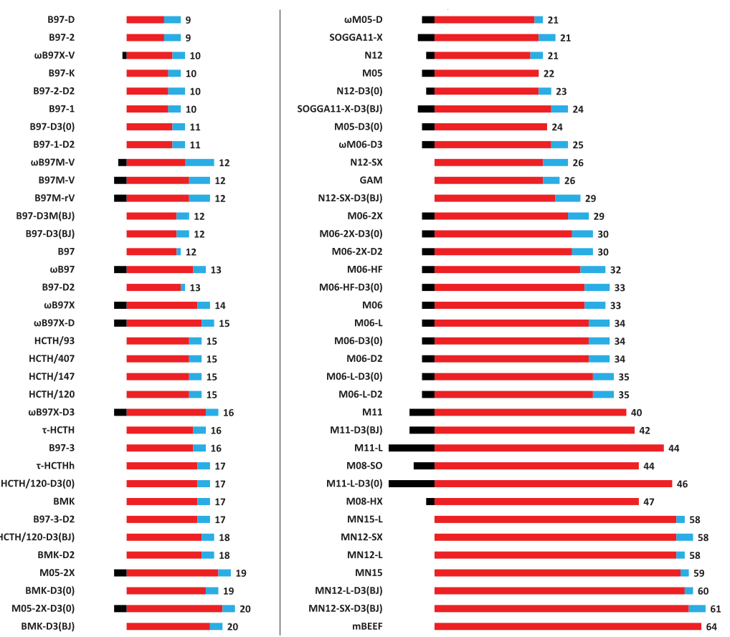
Is DFT non-empirical?

Slide 22
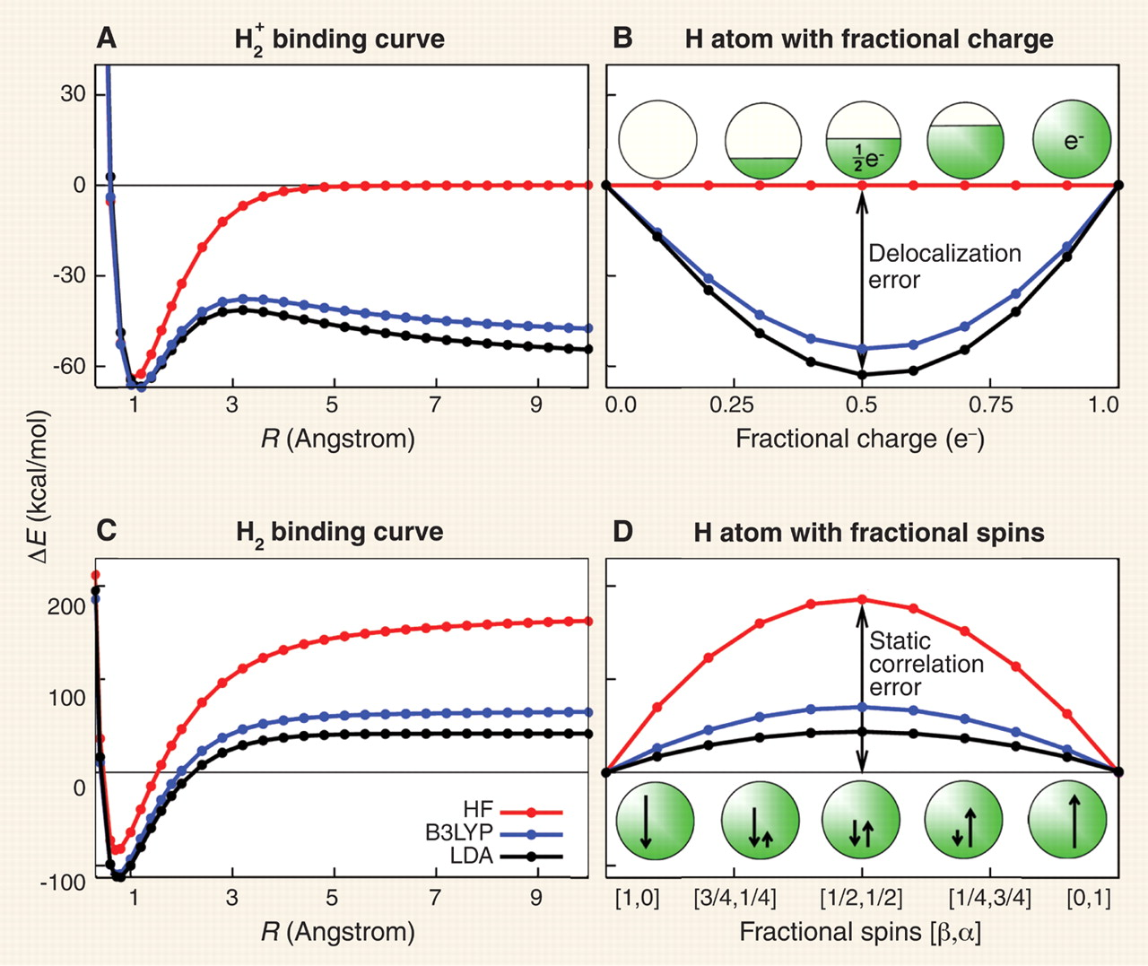
Issues with DFT
Limitations persist: (1) self-interaction error (SIE), (2) long-range dynamic correlation (dispersion), and (3) strong correlation.
self-interaction error
strong correlation
Cohen, A. J.; Mori-Sánchez, P.; Yang, W. Insights into Current Limitations of Density Functional Theory. Science 2008, 321 (5890), 792–794.

Slide 23
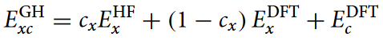
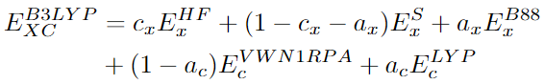
Global hybrid
For the first issue, one way to mitigate it is to replace fractions of the exchange functional with exact exchange (HF exchange) at all r. This is called the global hybrid functional (non-local DFT).
For example, c_{x} for B3LYP is 20%
Some common GH-GGA exchange-correlation functionals: B3LYP (Becke, Par), PBE0 (Perdew, Burke)
Some common GH-meta-GGA exchange-correlation functionals: TPSSh (Perdew), SCAN0 (Perdew), B97M (Head-Gordon), M06 (Truhlar)

Slide 24
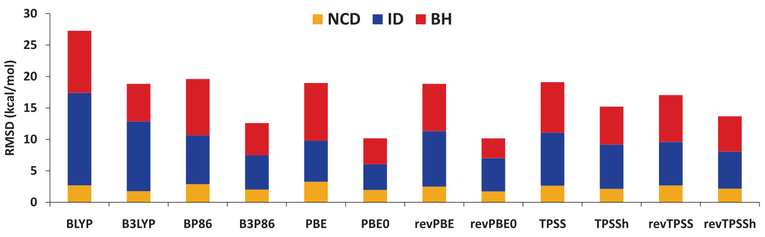
GH-DFT performance

Slide 25
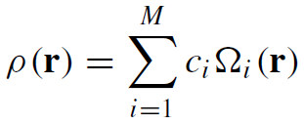
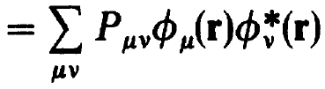
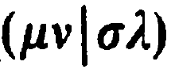
Scaling issue
DFT exhibits a lower scaling with respect to the size of the AO basis. This is because we can expand density using an auxiliary basis.
This density fitting scheme effectively reduces the scaling of DFT from N⁴ ( ) to N²M. Hence, the scaling bottleneck of DFT resides at matrix diagonalization (N³).
It is obvious then that GH-DFT has a higher scaling than pure DFT due to the need to solve for the HF exchange using KS orbitals (N⁴). Therefore, the application of GH-DFT is limited to smaller system sizes than pure DFT.

Slide 26
An empirical way to mitigate SIE
DFT exhibits a lower scaling with respect to the size of the AO basis. This is because we can expand density using an auxiliary basis.
This density fitting scheme effectively reduces the scaling of DFT from N⁴ ( ) to N²M. Hence, the scaling bottleneck of DFT resides at matrix diagonalization (N³).
It is obvious then that GH-DFT has a higher scaling than pure DFT due to the need to solve for the HF exchange using KS orbitals (N⁴). Therefore, the application of GH-DFT is limited to smaller system sizes than pure DFT.

Slide 27
Errors in DFT
Cohen, A. J.; Mori-Sánchez, P.; Yang, W. Insights into Current Limitations of Density Functional Theory. Science 2008, 321 (5890), 792–794.

Slide 28
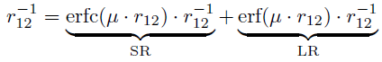
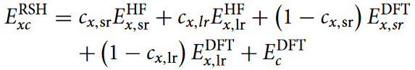
Range separation
Since SIE tends to exacerbate at long range, one way to mitigate this issue is to treat the amount of exact exchange differently at different distance.
These functionals are turned range-separated hybrid (RSH) functionals. Depending on at longer or shorter range the HF exchange is turned on, they can be further separated into long- or short-range corrected hybrid functionals.
Some common RSH-DFT exchange-correlation functionals: CAM-B3LYP (Handy), wPBE0 (Perdew), wB97X (Head-Gordon)

Slide 29
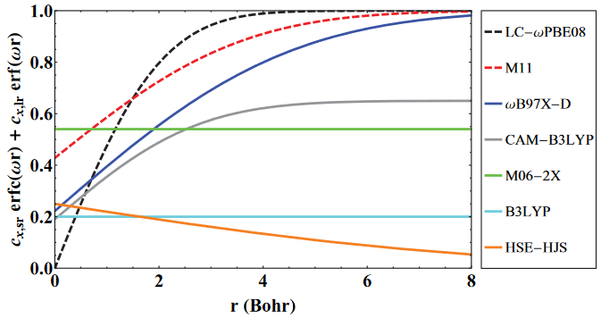
Range separation

Slide 30
Interactive
Navigate to CompChem/Practice/Week4/Exercise3
qsub xc_r.sub
watch -n 10 qstat -u ${USER}
After the submitted job disappears from qstat, open hybrid_functional_sie_plot.ipynb and run it
open hybrid_functional_dispersion_plot.ipynb and run it

Slide 31
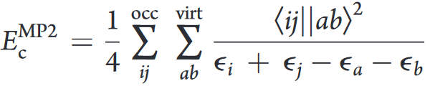
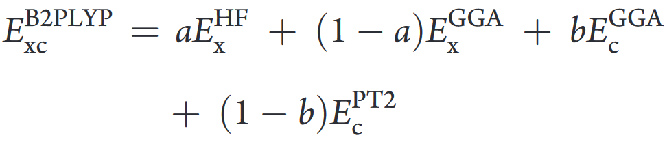
Double hybrid DFT
We have talked about ways to correct for the exchange interaction, which we know the asymptotic limit (self-interaction free for one energy). The correlation energy does not seem to have a systematic way to improve.
One way in the wave function theory to improve it is
Naturally, we will adapt it in DFT (however, the scaling is N⁵)
Some common DH-DFT exchange-correlation functionals: B2PLYP (Grimme), PBE0-DH (Adamo), wB97X-2 (Head-Gordon)

Slide 32
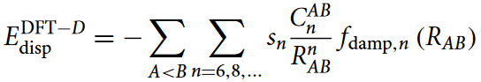
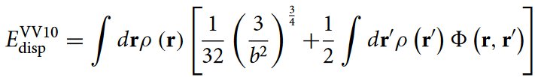
DFT and dispersion
For dispersion (long range dynamic correlation), there are two commonly employed ways to correct for it
An empirical damped atom-atom potential trained as an additive correction to the final energy
An additional term, whose parameters were previously fitted, in the KS equation that account for dispersion.
Non-local corrected functional: VV10 functionals {functional}-V.
Empirical dispersion corrections: D, D2, D3, D4

Slide 33

DFT and dispersion

Slide 34
Static correlation
Lastly, DFT and all other single reference (determinant) methods suffer from errors due to strong (static) correlation.

Slide 35




How good is good

Slide 36



Adiabatic connection method
For SIE, one way to mitigate it is to replace fractions of the exchange functional with exact exchange (HF exchange) at all r. This is called the global hybrid functional.
One

Slide 37

Adiabatic connection method

